Slide 1
Personality Disorder Improvement Programme
Moving from Consultation to co-design
Putting lived experienced at the heart of mental health support
Monday 7 November
11:00 – 12:00
Notes:
Alternative title and layout slides

Slide 2
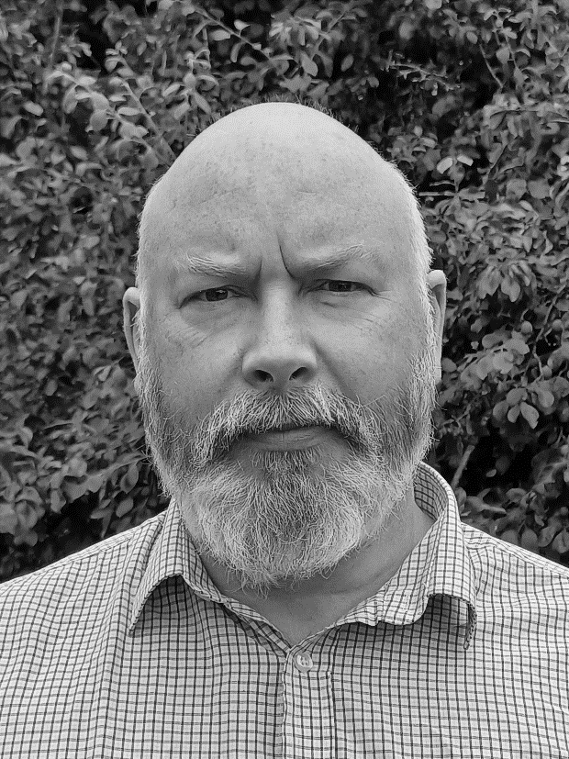
Welcome and introductions
Gordon Hay
Senior Improvement Advisor
Healthcare Improvement Scotland
Notes:
Alternative title and layout slides

Slide 3
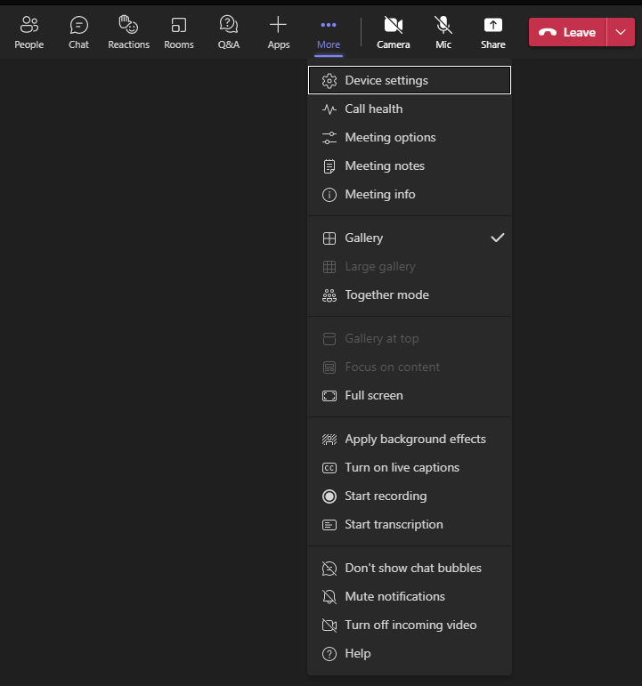
MS Teams Settings
How to open and close the chat panel – use the chat panel to introduce yourself, raise any questions you may have for the speakers and also post comments.
Under ‘more’ you can access some accessibility features such as live captions and also a live transcript of the meeting (highlighted with the arrow).
How to turn your camera on and off during Q&A session
How to turn your microphone on and off during Q&A session
How to leave the meeting
1
2
3
4
5

Slide 4
This Webinar will be recorded.
The link will be shared, so those who are unable to join us today can listen to the session.
Please do not record the session.

Slide 5
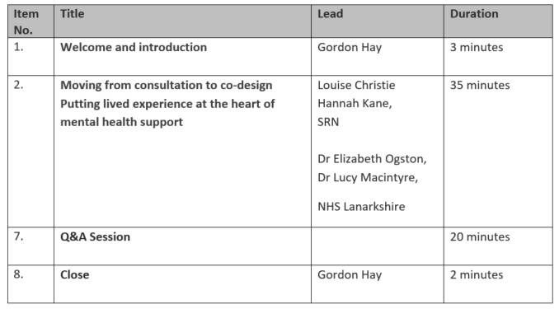
Agenda for today

Slide 6
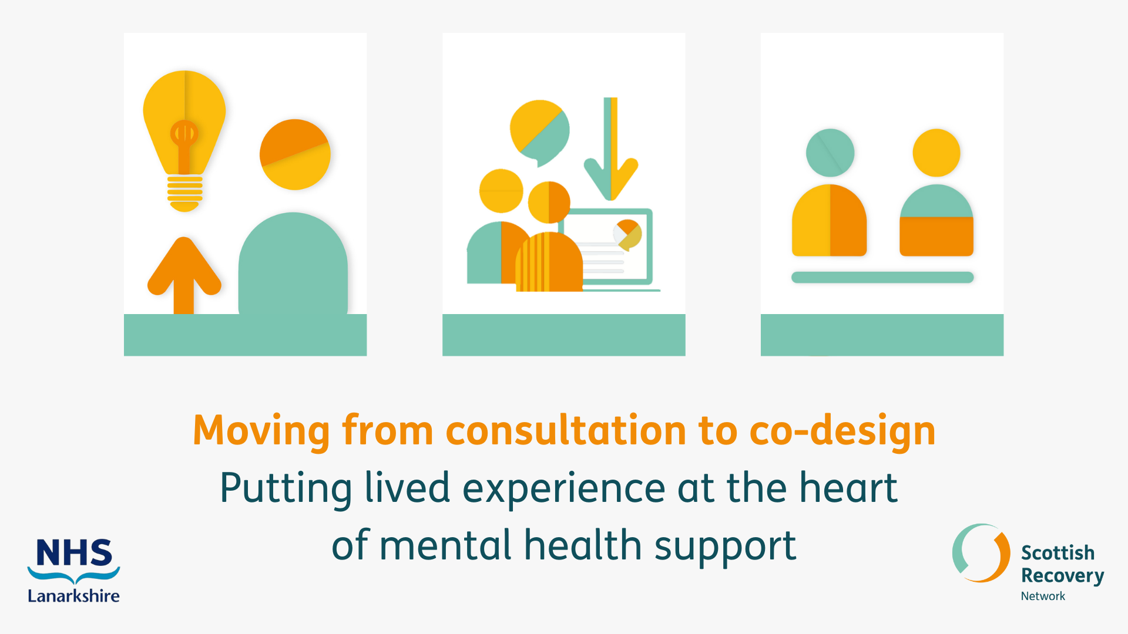

Slide 18
Polls

Slide 19
Next steps
Follow up
email circulated
soon
Workshop 3 – 6th December

Slide 20
Keep in touch
his.mhportfolio@nhs.scot
@SPSP_MH
To find out more visit
https://ihub.scot/improvement-programmes/mental-health-portfolio/personality-disorder-improvement-programme/

