Slide 1
NHS Dumfries and Galloway Neurodevelopmental Assessment (ND) Team
Redesigning the neurodevelopmental pathway for children and young people - Insights and Recommendations
In this case study
The Neurodevelopmental Assessment (ND) Team and partners in NHS Dumfries and Galloway have redesigned their neurodevelopmental assessment process, showing reduced cost and reduced waiting times for children, young people and their families.
Background
In early 2017 the ND Team recognised it had a long waiting list and was not able to meet current waiting time targets with its present capacity and structure https://www.isdscotland.org/health-topics/waiting-times/18-weeks-rtt/ . The Mental Health Access Improvement Support Team (MHAIST) helped the group understand the problem by holding a half day session. Using a fish bone and process mapping exercise the group was able to plan a way forward. https://ihub.scot/improvement-programmes/mental-health-portfolio/mhaist/
In 2018- 19 MHAIST led an improvement collaborative, focussing on improving access to Psychological Therapies and Child and Adolescent Mental Health Services (CAMHS). NHS Dumfries and Galloway and the neurodevelopmental project team and partners - including those with lived experience – were part of this collaborative and chose to work on reducing waiting times and improving the whole neurodevelopmental assessment process.
The new team recognised that multiple pathways needed to be aligned so that families could experience a streamlined assessment process which produced a child’s profile that was helpful to the family.
The team decided to focus on the following outcomes:
All children with non-complex presentations will be assessed and diagnosed within 12 weeks of referral by end of 2019
All children with complex neurodevelopmental presentations will be assessed and diagnosed within 26 weeks of referral by end of 2019

Slide 2
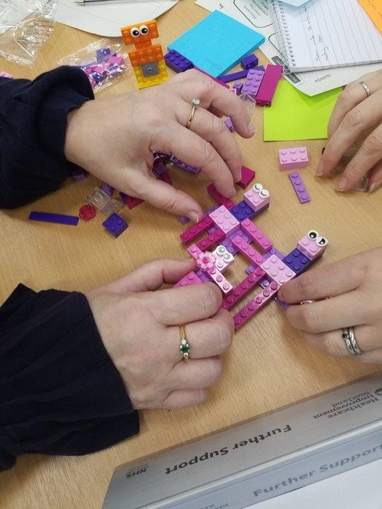
Preparation and engagement
The team worked in collaboration with families who had experience of the service to review the pathway for all neurodevelopmental referrals aiming to reduce waits, as well as improving the overall experience for families. They used process mapping to understand the administrative aspects of the pathway and identified ways to reduce duplication and streamline the assessment process. The new pathway crucially also included a final diagnosis template and a profile for all children and families, outlining each child’s strengths and difficulties.
Central to the team was a parent who had experienced the existing pathway who ensured that views from other families were represented. Parental views were also sought through a local parent support group (https://twitter.com/squarepegscot). This involvement has consisted not only of consultation on proposed processes, but active involvement in the redesign. The parent very much kept the group focussed on value including a more useful child’s profile.
Prototyping
Following the redesign of the pathway, MHAIST facilitated a full day prototyping session with the team to support them to draw together all the existing work and virtually test the new pathway while identifying next steps.
Testing the pathway
This prototyping session helped get a shared purpose for the team identifying next steps to test the new pathway (shown in figure 1). With support from MHAIST, the team developed an action plan to test the aspects of the pathway identified at the prototyping day.
Data was collected from 10 cases on the old ND Team waiting list and on 10 cases undergoing the new assessment process and then compared to understand the impact, build a business case to secure long term funding for the team, and identify a clear governance structure for a future service.
Crucially, MHAIST and the Evidence and Evaluation for Improvement Team (EEvIT) within Healthcare Improvement Scotland used data gathered to calculate health economics and cost savings to support this business case.
The pathway was tested on a symbolic family who virtually moved through each stage of the process. This gave the team an opportunity to understand the experiences of families and the parent member of the team was able to give a view of each stage of the process.

Slide 3
NHS Dumfries and Galloway - New Neurodevelopment Pathway
Admin
Referral Received
Admin screen carried out
Triage
Assessment
Complex Assessment
Support
Complex
Prepare for Triage
Check family understand the referral
Consent family to request screening info
Contact details for school
ND history to family
Education request
Collate info for triage
Update database
Triage Meeting
Allocate case lead
Allocate second
First Appointment
Family
Case lead
Second
May change from standard to complex or vice versa during assessment process
Report Drafted
Clinical outcome evidenced
Feedback Appointment
Family
Case lead
Second
Report Concluded
ND
Standard Assessment
Not ND
Non-complex
Discussion with Family
Not neurodevelopmental
Signposting
to alternative support services
Post-diagnostic Support
Discharge
Report sent
Database updated

Slide 4
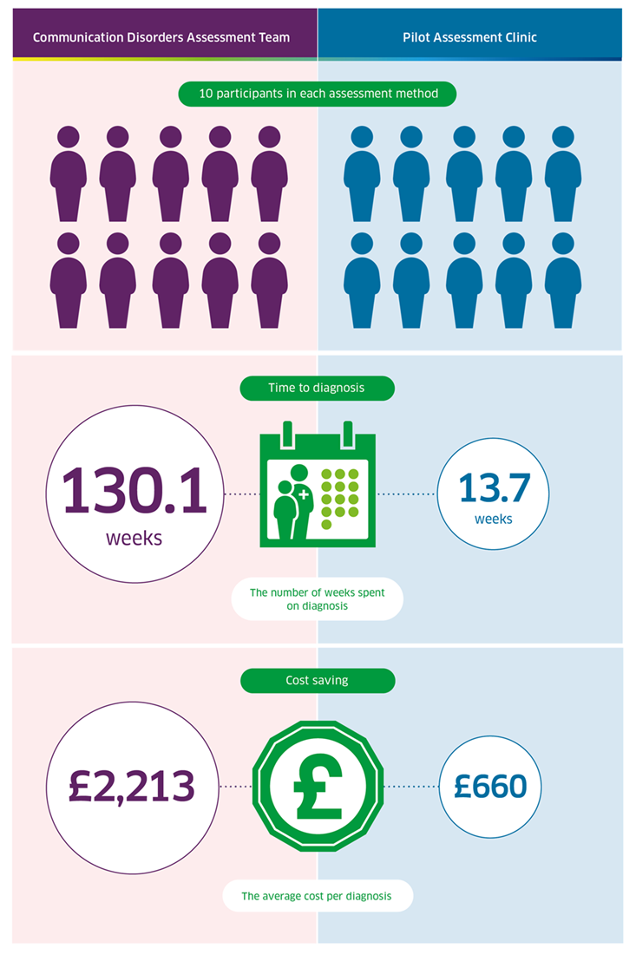
Comparison of Communication Disorder Assessment Team with New ND Assessment Clinic
What was the impact of this work?
The new pathway has led to improvements in waiting times, and efficient use of time and resources for families and staff, while maintaining standards of care:
The average number of times each case prompted a direct contact with the family (family contact events) reduced from 25 to 5 events
The average time spent on direct family contact reduced from 20 hours to 6 hours
The average staff time per case was reduced from 36 hours to 10 hours
The average time to diagnose reduced from 130.1 weeks to 13.7 weeks
The average cost per young person assessed was calculated to be a reduction from £2213 to £660.

Slide 5
Next Steps and Reflections
Continuing to make use of a QI approach, the ND Team followed the pathway with a further 25 people and are currently testing at a larger scale with 200 people. The onset of COVID-19 has affected waiting lists and demand for services and the team have opened their referral system to respond to this increase in demand. They have also reviewed the multi-disciplinary membership of the assessment team to ensure integrated team working continues. Data will be collected to help the team monitor the impact, understand how this can be adopted at a larger scale, and continue to build a business case for financial support.
Reflections from the team:
The single most important factor is to work with families who have experience of the service and co-design with them
If you need to build a case for extra capacity/ finance then build this into your project
Be clear on what you want to demonstrate
Be clear about the difference you want to make and the data you will need to evidence this, including economic data
Look for people within the organisation that can help you with gathering and analysing data
Identify the data you need in order to make an economic assessment.

