Slide 1

Housing Solutions
Module 1

Slide 2
Module Objectives
Module 1 | Housing Solutions
By the end of the module staff will be able to
Describe the key principles and aims of the
Adapting for Change programme
Outline the key considerations for the effective identification of Housing based solutions
(exploring rehousing, technology,
equipment, and adaptations) across all tenures
Describe the importance of acting early and key elements of the ‘right housing conversations’
Explain their role in supporting people to
understand the options available

Slide 3
Adapting for Change programme: Key Themes
Module 1 | Housing Solutions
Partnership, governance and management –
strategy jointly developed, shared priorities, jointly accountable, better use of resources including money
Better design – less waste, better recycling...
Streamlined services – tenure neutral, reduced complexity, reduction in waiting times...
Widened scope – people with wider needs are supported
e.g. dementia; wider range of options e.g. technology, self-help...
Integrated – easier access, seamless processes,
effective signposting
Person centred – focus on evidencing personal outcomes
Prevention – timely provision, avoiding crisis!

Slide 4

Adapting for Change
5 demonstration sites
Module 1 | Housing Solutions
Aberdeen
Borders
Falkirk
Fife
Lochaber
Notes:
Programme approach across all 5 sites
Focus on evidence and outcomes
2 consistent outcome measures across all the sites
Timescales
Outcome for the person ( and functionally)
Key lessons learned – captured as they are emerging – will be shared via web pages, plus case studies
External Evaluation by SG

Slide 5
AfC – 5 demonstration sites…
Module 1 | Housing Solutions
All 5 sites undertook tests of change in the following areas
Improving partnership arrangements; strategy, processes and governance
Service redesign to shorten timescales and enhance fast tracking
Improving communication and choice and allied information and advice
Developing a person-centred approach with a focus on outcomes for the person
https://ihub.scot/place-home-and-housing/
Plus specifically
Aberdeen – integrating TEC solutions , enhancing housing input to improve
hospital discharge
Borders – tenure neutral approach
with shared budgets amongst RSLs
Falkirk – developing standardised tools, definitions and templates, plus a Joint Outcomes and Performance Framework
Fife – new approach to triage at first point
of contact and developing front line housing management and housing options role to provide speedier and more effective service
Lochaber – tenure neutral approach
with a one stop shop with direct access
to a wide range of services

Slide 6
Housing based solutions…
Module 1 | Housing Solutions
Housing Solutions = is an approach derived from the AfC programme and provides an overall framework for the provision of effective housing outcomes. It emphasises and supports:
  the importance of front-line staff ‘acting early’ and having good ‘housing conversations’ when someone's circumstances change, encouraging consideration of rehousing as first stage… (Falkirk leaflet)
  Encourages an Asset based solutions approach, with the person having full ownership and control…
  Recognises ‘triggers’, ……..and supports Anticipatory care planning….
  Supports Prevention, and avoidance of ‘crisis’ …. and Appropriate risk taking…..
  Can be supported by local and national Housing Options services
Technology – telecare is an example of technology that can help people remain in their own home…
Equipment – a wide range of cost effective/simple equipment solutions can support people in their own homes…
Adaptations – ‘any alteration or addition to the structure, access, layout or fixtures of accommodation and any equipment or fittings installed or provided for use in accommodation, for the purpose
of allowing a person to occupy or to continue to occupy, the accommodation as their sole or main residence’

Slide 7
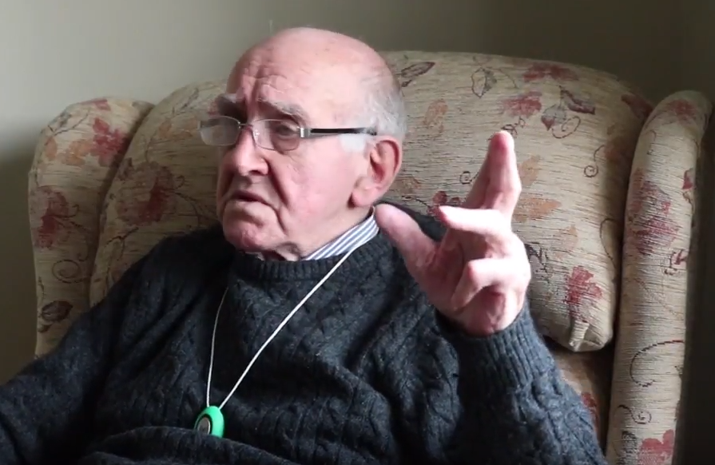
Housing Solutions, in action…
Housing Solutions
Mr F’s story….
SCW had a ‘Housing Solutions’ conversation with Mr F, following a bathing assessment;
Mr F agreed to consider rehousing & discuss with son;
Mr F rehoused in smaller property and now able to go out and enjoy social activities.
Insert photo?

Slide 8
Case studies Exercise 1 – ‘Acting early’
Read the case studies and discuss the following in your Groups:
What should have been the ‘triggers’ to intervene much earlier, and have a ‘housing conversation’?
‘who’, should have done, ‘what’, and ‘when’?

Slide 9
Case Studies – people’s stories…
Mr D
Home owner, age 76, lived in his family home for 41years
House over 2 floors with bathroom/bedroom upstairs
He has diabetes, a previous below knee amputation in 2014, & diagnosed with dementia in 2015
Latest hospital admission resulted in a second below knee amputation
Previously had SW OT and housing involved following first amputation when identified that house not suitable for adaptation – needs ground floor facilities and wheelchair accessible
Declined previous property offers, referred to housing and then again declined offer (after accepting) when he was in hospital the second time;
Refused to move, and against advice, privately fitted his own stairlift. SW reviewed their position and agreed to fit ramps, shower adaptation.
Mr D was admitted to hospital 1/9/15, he was ready for discharge 16/12/15…..but was actually discharged in June 2016 (191 days delayed)

Slide 10
Case studies – peoples stories
Mr G
73yrs old and lives alone in first floor private rented flat
He has diabetes and chronic renal failure (on dialysis at home)
Admitted to hospital for assessment 11/12/15 but with likely outcome of amputation. Ready for discharge 23/1/16 remained in hospital at July 2016….
Rehousing first identified as an issue 22/1/16 (day before ready for discharge)
He needs 2 bedrooms to accommodate dialysis equipment and full wheelchair access. Current home assessed as not being suitable due to limited wheelchair access.
He refused new purpose built property as “too far away”. Offered second property in more suitable location but said this had “come too soon”
Refused to move to nursing home in the interim and remained in hospital…..

Slide 11
Case studies – peoples stories
Mrs E
Mrs E is 62 and lives alone in a ground floor HA flat. She has lived there for 22years.
She has diabetes, asthma, epilepsy and has had a stroke. Following hospital admission she is now a wheelchair user.
Admitted to hospital with cellulitis and was unable to mobilise. She is bariatric.
Had to be taken out of her property via the window due to her size. Property no longer suitable as too small for the equipment she requires;
Admitted to hospital 13/3/15; fit for discharge 15/6/15
Mrs E is not prepared to accept that her property is unsuitable and wants to return there;
Had had a previous housing referral in May 2014 and then re-referred on the day she was ready for discharge 15/6/15
Eventually she was moved into intermediate care but has not been rehoused . She reused an offer of sheltered housing as didn’t understand what it was.

Slide 12
Case studies – peoples stories
Mrs S
Mrs is 85 and lives in her own home – her mother was born in the house which is in a rural area;
Two storey property with main bathroom/bedroom upstairs. Toilet and sink downstairs, with large dining room, lounge and kitchen
Husband died 6 months ago. Her daughter lives next door. She want to remain in her home and is happy washing at the sink.
She is on medication for her heart condition, blood pressure, water retention and is now on anti-depressants.
She's had several falls both inside the home and when attending the local lunch club. She attended hospital for the external fall but did not tell staff about the other incidents. She has stopped attending the lunch club.
OT previously has installed rails. Physio has provided a walking stick and advised strength and balance exercises which Mrs S did not follow up.
Medication has been making her dizzy and GP has reviewed to try to improve these symptoms

Slide 13
Case studies Exercise 2– ‘the right housing conversations’
Show the following clip to set the tone for this next exercise - https://vimeo.com/66753575
discuss the following in your Groups:
What would the right ‘housing conversation’ sound like - what would you say, how would you say it, who else could be involved?
What should it not be …..?

Slide 14
Case studies Exercise 3 - ‘Roles and Responsibilities’
discuss the following in your Groups:
Recognising that Housing Solutions is about a different approach, encouraging earlier intervention, what do you think your Roles and responsibilities should be in trying to deliver a ‘Housing Solutions’ approach?
What will you do differently going forward…..?
What information and support would help…?

Slide 15
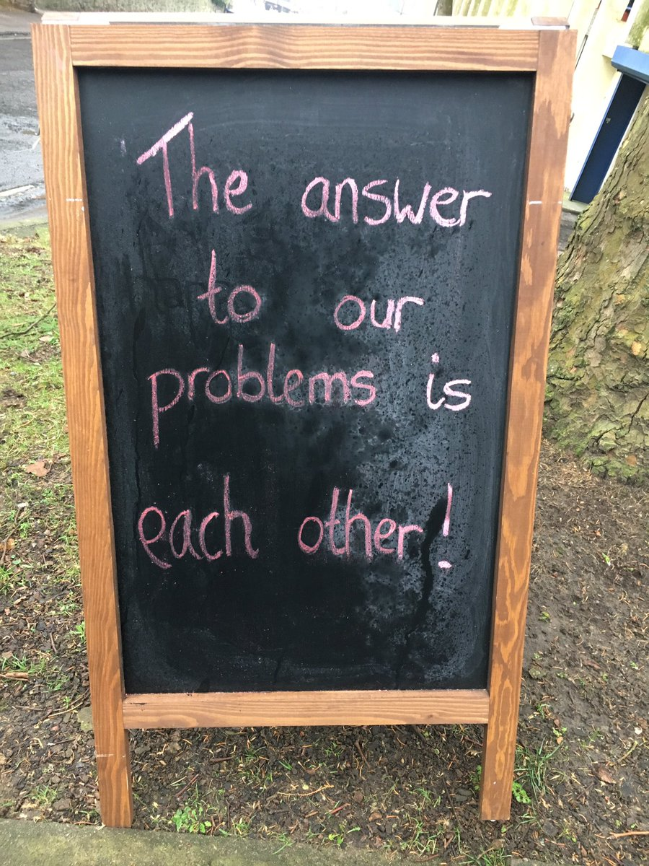
Roles and responsibilities…. supporting personal outcomes
Module 1 | Housing Solutions
Housing Solutions is everyone’s business…encourage communication and joint working between partners/agencies
‘Sow the seeds’, & be empowered to have a ‘housing conversation’…signpost people and use leaflets /communication materials….
Think ‘simple solutions’…realistic and practical
Focus always has to be on a personal outcomes approach…

Slide 16

Module Summary
Module 1 | Housing Solutions
Any last Q’s……
Evaluation

