Slide 1
Ethical Considerations for User Research and Service Design
Supporting better quality health and social care for everyone in Scotland

Slide 2
Why do we need to think about ethical considerations?
When involving people, they should
feel listened to
feel safe
be able to contribute with a sense of agency and empowerment
feel included
Notes:
When engagements are meaningfully designed considering various backgrounds and experiences, participants feel safe and able to contribute. Participants are given a sense of agency and empowerment. They have an active role in the development of services that are person-centred and take into account people's different needs.

Slide 3
Taking a trauma informed approach to our work
Supporting better quality health and social care for everyone in Scotland
Notes:
Alternative title and layout slides

Slide 4
What’s in the package
Will be available on: Designing person-centred services for housing, social care and health | HIS Engage
Notes:
Key principles of trauma-informed practice
Why is ethical engagement important?
Ethical engagement DO's and DONT's
checklists
Why we needTrauma-informed engagement

Slide 5
Resources
Healthcare Improvement Scotland (n.d.). Meaningful Engagement Matters by Community Engagement. https://www.hisengage.scot
NHS Education for Scotland. (2022). National trauma training programme | Turas | Learn. https://learn.nes.nhs.scot/37896/national-trauma-training-programme
‌NHS Education for Scotland (2019, December 03) Sandra Ferguson - Leading the National Trauma Training Programme. [Video] https://vimeo.com/377019393
The Scottish Government (2021). Trauma-Informed Practice: A Toolkit for Scotland. Scotland. https://www.gov.scot/publications/trauma-informed-practice-toolkit-scotland/ (Report No. PPDAS814746 (01/21))

Slide 6
Key principles of trauma-informed practice
Source: The Scottish Government (2021). Trauma-Informed Practice: A Toolkit for Scotland. ( Based on NES TIP principles cf Fallot and Harris, Trauma-Informed Services: a Self-Assessment and Planning Protocol, 2006)
Notes:
NES TIP principles (Safety, Trust, Choice, Collaboration and Empowerment) ( cf Fallot and Harris, Trauma-Informed Services: a Self-Assessment and Planning Protocol, 2006)

Slide 7
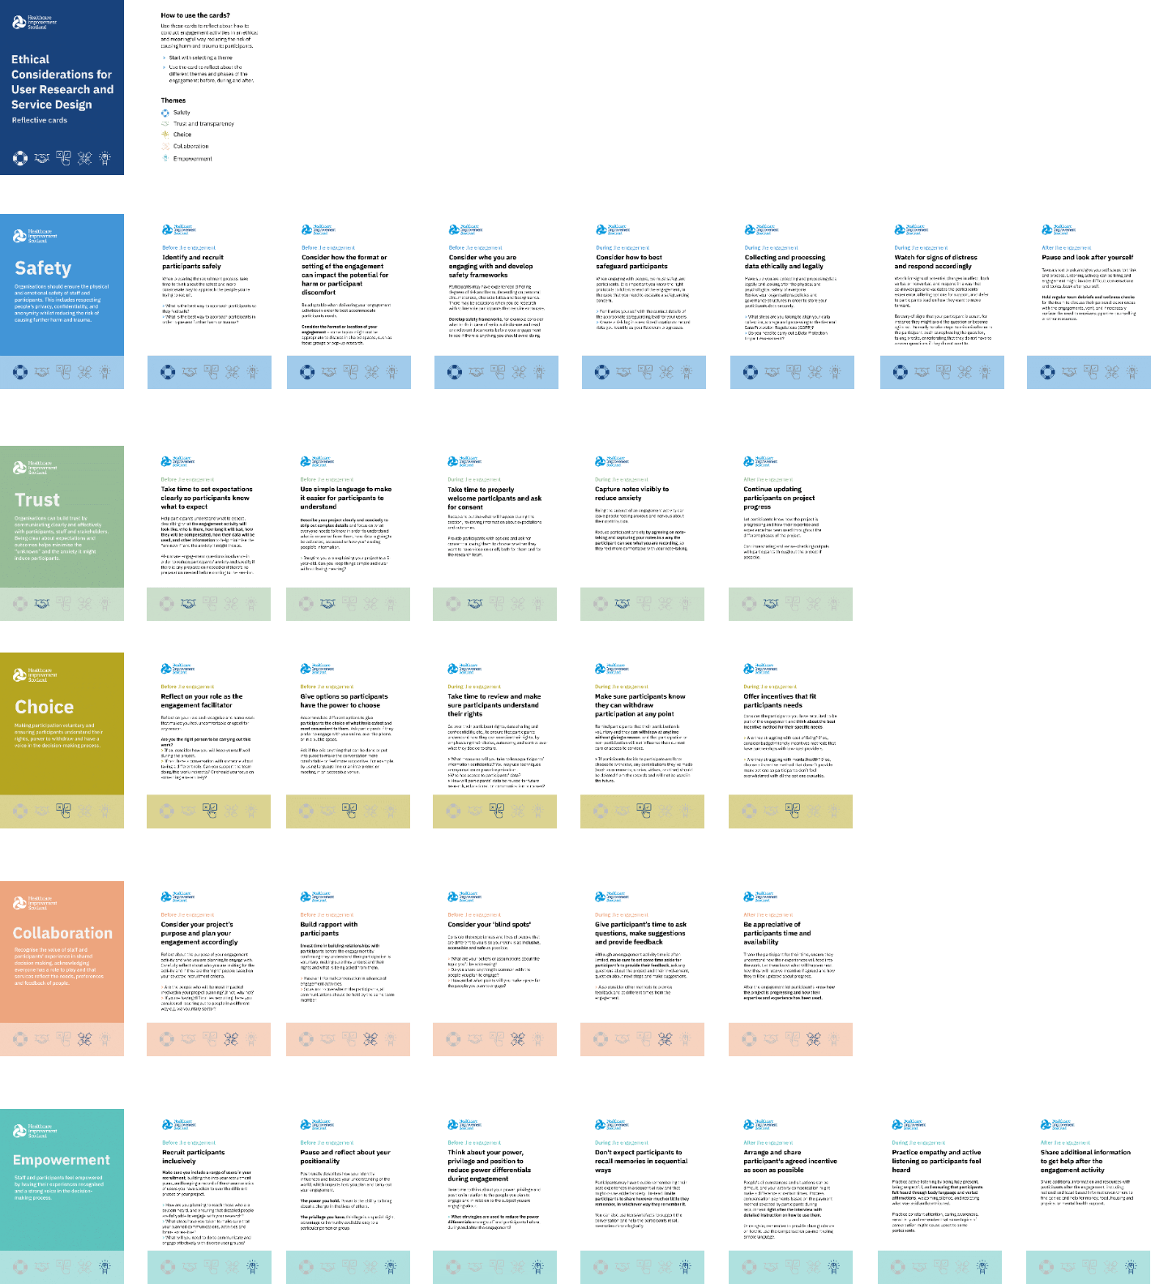
Ethical Engagement Cards
Notes:
Phases and prompts

Slide 8
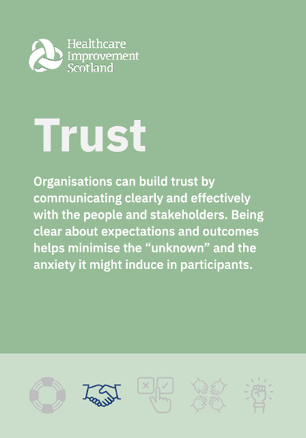
Breakout room activity
Discuss in groups – 20 min
Share feedback - 15 min
What are the challenges you have come across when building and maintaining trust when involving people?
Are there any tips, best practices or ‘how to’ examples you would like to share?
Any other points to go in the cards?
Notes:
What did you find most challenging and why?

