Slide 1
digitaloffice.scot
Implementing Service Design in Local Government
Design Community of Practice
Synnøve Frøiland
29th November 2023

Slide 2
Background

Slide 3
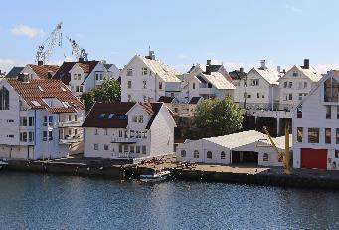
Background
From Norway
Worked as a safety engineer in the oil and gas industry
Studied more to change career; human centred design, UX and design thinking

Slide 4
Background
Worked alongside UX designers in a software development company
Worked as a service design consultant
Started working for the Digital Office for Scottish Local Government in January

Slide 5
The Digital Office for Scottish Local Government
Background
The Digital Office’s purpose is to ensure that the infrastructure and capabilities are in place to help councils increase the pace of Digital Transformation and to deliver on the ambitions of the National Digital Strategy.
Implementing the Scottish Approach to Service Design (SAtSD) is part of the National Digital Strategy.

Slide 6
New on the Job

Slide 7
New on the Job
Question
How do I, in this role, create as much value as possible for local government?
Implementing Service Design in Local Government

Slide 8
New on the Job
A lot to learn and understand
The 32 councils
Digital Office role
Other players in the field
My role
Good work had been done before I started
Scottish Approach to Service Design
Local Government Service Design Group
Created a strategy
I was asked to create a strategy and a plan for what work was to be done next

Slide 9
New on the Job
Service Design Strategy
I shared the following first draft with the
Local Government Service Design Group
One solution for all councils
ALIGN
Vision, mindset, process, toolset, language and goals
SHARE
Information on statutory services. Map common challenges and goals. Collaborate on solutions. Gather lessons learned and case studies for each service.
EMBED
Best Practice. Procedures. How do we embed service design into normal day to day activity?
EXPAND
Collaborate with national government, health, public bodies, third sector and the private sector: Common goals, knowledge exchange

Slide 10
New on the Job
Dead silence. No Questions. No comments
I knew there was a lot I did not understand. The strategy was based on very limited information. I decided to use the service design approach and started having conversations with my main clients: the people doing service design in councils.
1-2-1s with people doing service design in councils

Slide 11
What I learned from the 1-2-1s

Slide 12
What I learned from the 1-2-1s
19 conversations with people from 15 different councils
Implementing Service Design in Local Government

Slide 13
What I learned from the 1-2-1s
What they said works well
Local Government Service Design Community (LGSD-group)
Sharing of service design work and experience between councils
Several councils are on their way toward implementing service design in their organisation
Merging Service Design practice with already existing ways of working

Slide 14
What I learned from the 1-2-1s
What they said the challenges are
Limited budget and resources
Chief executive and management buy-in
The focus is on using service design to save money rather than creating services that work for people
“Service Design” intimidates, lack of confidence
Training people is easy but getting them to do service design is hard
Mindset: “We already know best what our service users need, no need to investigate it further”
Harmonising the service design role with other roles in the council

Slide 15
What I learned from the 1-2-1s
What they said the challenges are
Service designers leave councils for better paid jobs elsewhere, and the opportunity for career development
Confusion around what guidelines or legislation to follow
Confusion around how the different organisations relate to them and what each of them can offer (i.e. The Scottish Government, the Scottish Digital Academy, the Improvement Service, Scotland Excel, COSLA, CivTech)
“There is no national framework for how to implement service design according to the Scottish approach to Service design”

Slide 16
What I learned from the 1-2-1s
I received feedback on the strategy:
“That’s all good for the councils who are new to implementing service design. We have done this work already. We don’t benefit from this strategy. What’s in it for us? ”
Implementing Service Design in Local Government

Slide 17
What I learned from the 1-2-1s
I asked:
“What do you suggest we do instead?”
Implementing Service Design in Local Government

Slide 18
What I learned from the 1-2-1s
“There is a Service Design Maturity Matrix as part of the Scottish Approach to service design.
We are working on an action plan on how to get to the next level of the Maturity Matrix. It would be good to get support with this work.
If you divide the local government service design group according to maturity level, everyone can start collaborating with others who are experiencing similar challenges as themselves.”
Implementing Service Design in Local Government

Slide 19
What I learned from the 1-2-1s
I started asking the members of the Local Government Service Design Group to provide assessments of their council’s service design maturity according to the Scottish Approach to Service Design.
Accurate assessments were not required, just enough information to know how to divide everyone into the right collaboration group. It would be sufficient for the people doing service design in councils to make the assessment themselves.
Implementing Service Design in Local Government

Slide 20
Service Design Maturity Assessment
Local Government
Results as of November 2023

Slide 21
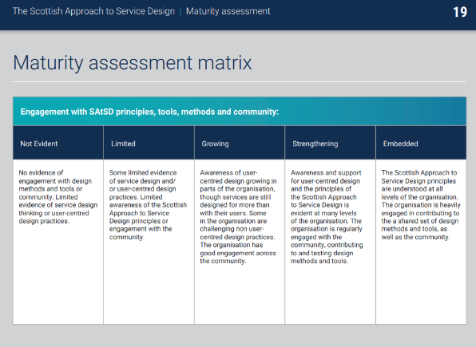
Service Design Maturity Assessment Local Government
Maturity Assessment of 17 councils
16 self-assessments done by people doing service design in councils
1 external assessment done by a consulting agency
Some assessments were done by the person doing service design themselves
Other assessments were done more thoroughly in collaboration with other people in the council
Some assessments were of the council as a whole
Other assessments were of the department where the people doing service design work
Implementing Service Design in Local Government

Slide 22
Service Design Maturity Assessment Local Government
Result: Assessment of 17 Councils
 | 1. Not Evident | 2. Limited | 3. Growing | 4. Strengthening | 5. Embedding
Engagement with SAtSD principles, tools, methods and community
Capacity and capability for SAtSD
Focus on user and life events / problems they need the service to solve
User participation in project research and design activities
User inclusion and accessibility needs for participation in design
Implementing Service Design in Local Government

Slide 23
Service Design Maturity Assessment Local Government
Result: Assessment of 17 Councils Simplified
 | 1. Not Evident | 2. Limited | 3. Growing | 4. | 5.
Simplified Maturity Level
Implementing Service Design in Local Government

Slide 24
Service Design Maturity Assessment Local Government
Group 1
Group 2
Group 3
Getting from maturity level 1 to 2
Wait to start collaboration group for councils until we have a recommended plan.
Getting from maturity level 2 to 3
Regular collaboration sessions planned for 2024
Getting from maturity level 3 to 4
Regular collaboration sessions planned for 2024

Slide 25
What I learned from the 1-2-1s
Service Design Maturity Assessment Local Government
1
2
3
4
5
Engagement with SAtSD principles, tools, methods and community
Capacity and capability for SAtSD
Focus on user and life events / problems they need the service to solve
Implementation plan for SAtSD in Local Government
User participation in project research and design activities
User inclusion and accessibility needs for participation in design

Slide 26
What I learned from the 1-2-1s
Service Design Maturity Assessment Local Government
1
2
3
4
5
Engagement with SAtSD principles, tools, methods and community
Capacity and capability for SAtSD
Focus on user and life events / problems they need the service to solve
Implementation plan for SAtSD in Local Government
User participation in project research and design activities
User inclusion and accessibility needs for participation in design

Slide 27
Outcome

Slide 28
Outcome
The information gathered from people doing service design in councils has helped inform several decisions and outcomes
Implementing Service Design in Local Government

Slide 29
Outcome
Shaped the new strategy and 2-year workplan
Everything we do will be tied in with the Implementation Plan for the Scottish Approach to Service Design.
Changed the way we do our local government meetups
From 2024 and onward there will be a bigger focus on collaboration according to maturity level in our Service Design for Local Government meetups. The work will be aligned to developing the implementation plan.
Kept what works well
We will keep a space for the local government service design group to share their service design work and experience between themselves, regardless of maturity level.
Implementing Service Design in Local Government

Slide 30
Outcome
Service Design Workshop for senior leaders to be held
12th of December for the Digital Partnership, by
The Digital Office and Snook. An answer to people doing service design in councils often experiencing a lack of buy in from management.
Informed internal collaborations
Looking at including the service design maturity assessment in the digital maturity assessment that the Digital Office already offers local government.
Helped shape the service design sessions Snook will have with local government as part of the Service Design Challenge project.
Informed external collaborations
The Improvement Service: decided to align our offers to needs that will be uncovered during the implementation plan work.
The Scottish Digital Academy: decided to align training and courses offered to needs that will be uncovered during the implementation plan work.
The Office of the Chief Designer: helped decide what information and support we requested from them. Given them feedback on the use of the SAtSD in LG.
Implementing Service Design in Local Government

Slide 31
Thank
You

